Slide 1
Applying the Shuffle Model of Differential Privacy to Vector Aggregation
Mary Scott
Joint work with Graham Cormode and Carsten Maple
Accepted by British International Conference on Databases (BICOD)

Slide 2
Research Motivation
Differential Privacy (DP) is a strong, mathematical definition of privacy in the context of statistical and machine learning analysis.
Provides mathematically provable guarantee of privacy protection against wide range of privacy attacks,
e.g. differencing attacks, linkage attacks, reconstruction attacks.
Ensures that any given disclosure is within a small multiplicative factor, whether or not an individual participates in the dataset.

Slide 3
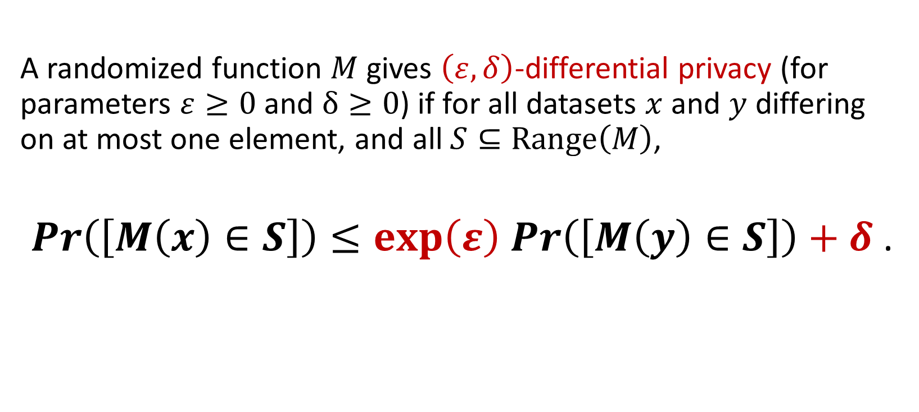
Research Motivation
A randomized function $M$ gives $\left(ε,δ\right)$-differential privacy (for parameters $ε≥0$ and $δ≥0$) if for all datasets $x$ and $y$ differing on at most one element, and all $S⊆Range\left(M\right)$,
$\operatorname{Pr}\left(\left[M\left(x\right)∈S\right]\right)≤\exp\left(ε\right)$ $\operatorname{Pr}\left(\left[M\left(y\right)∈S\right]\right)+δ$ .

Slide 4
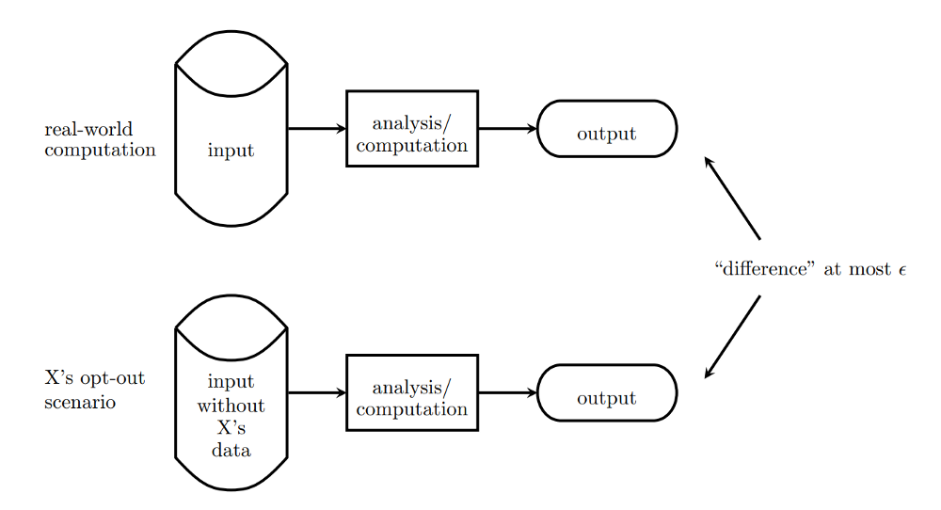
Research Motivation

Slide 5

The Shuffle Model of DP
The (Single-Message) Shuffle Model sits in between the Centralized and Local Models of DP:
noise required per user for same privacy guarantee is not as high as in the Local Model.
Introduces an additional “shuffling step” to the Local Model:
after the data from each user is encoded, it is randomly permuted to unbind each user from their data before analysis takes place.

Slide 6
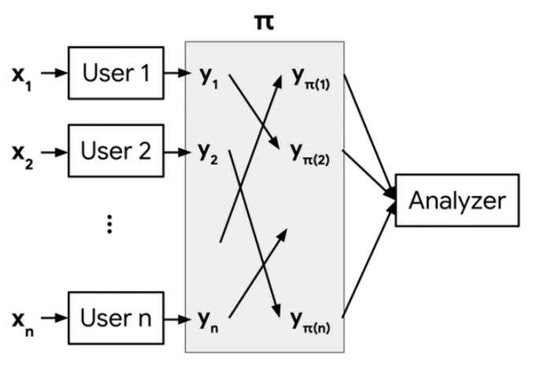
The Shuffle Model of DP

Slide 7
Extending the Shuffle Model to Vectors
Extended “The Privacy Blanket of the Shuffle Model” (Balle et al., 2019) to be applicable to vectors rather than just scalars.
Two contributions:
an optimal single message protocol for summation of real vectors in the Shuffle Model,
and an improvement of this bound through implementation of a Discrete Fourier Transform (DFT), which minimises initial error at expense of the loss in accuracy.

Slide 8
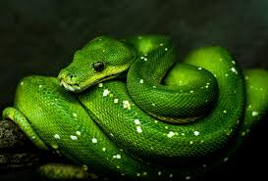
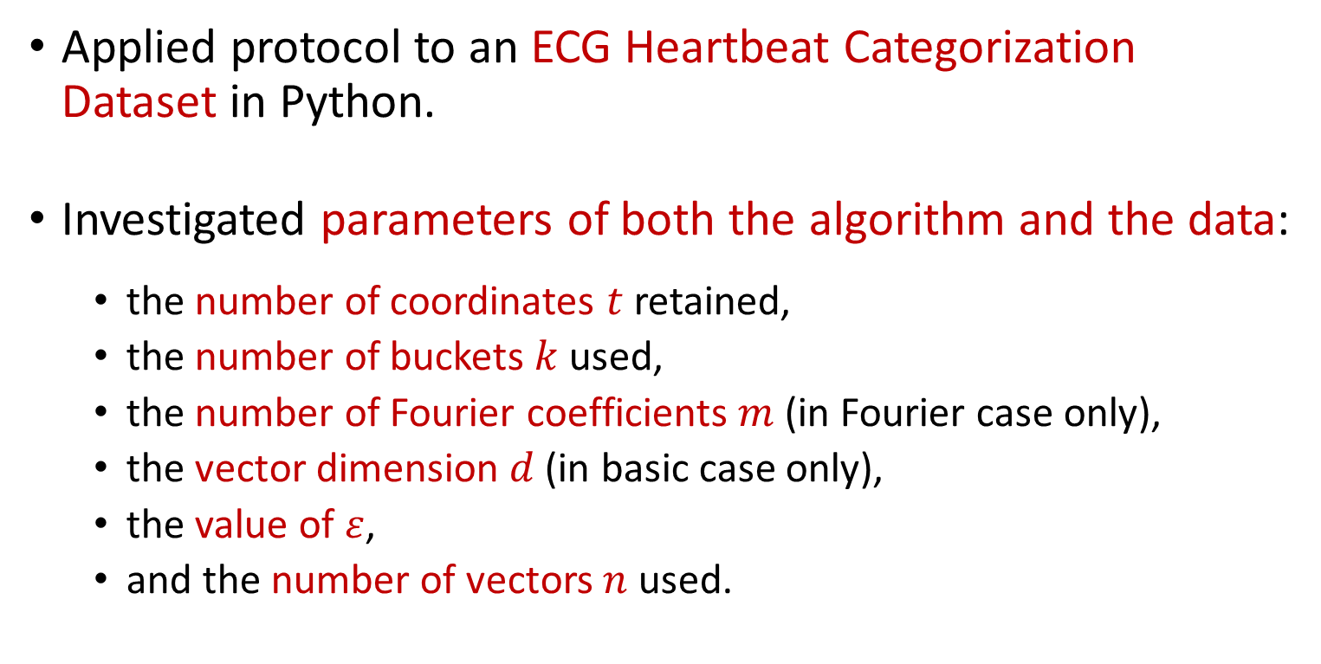
Experimental Evaluation
Applied protocol to an ECG Heartbeat Categorization Dataset in Python.
Investigated parameters of both the algorithm and the data:
the number of coordinates $t$ retained,
the number of buckets $k$ used,
the number of Fourier coefficients $m$ (in Fourier case only),
the vector dimension $d$ (in basic case only),
the value of $ε$,
and the number of vectors $n$ used.

Slide 9
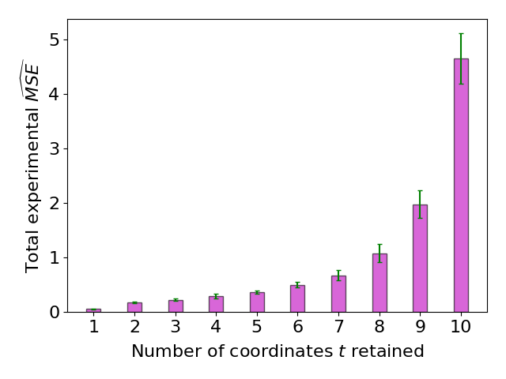
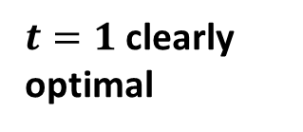
$t=1$ clearly optimal

Slide 10
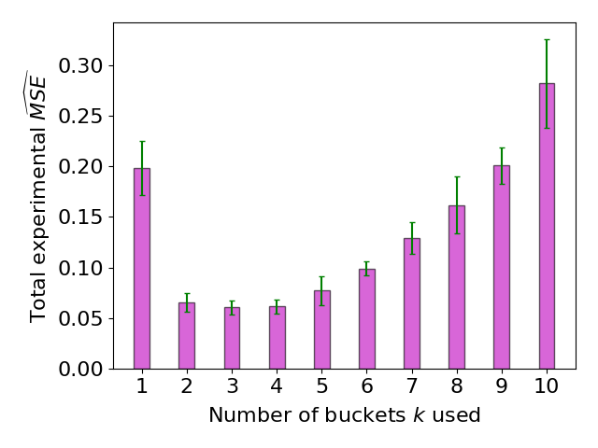
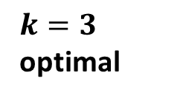
$k=3$ optimal

Slide 11
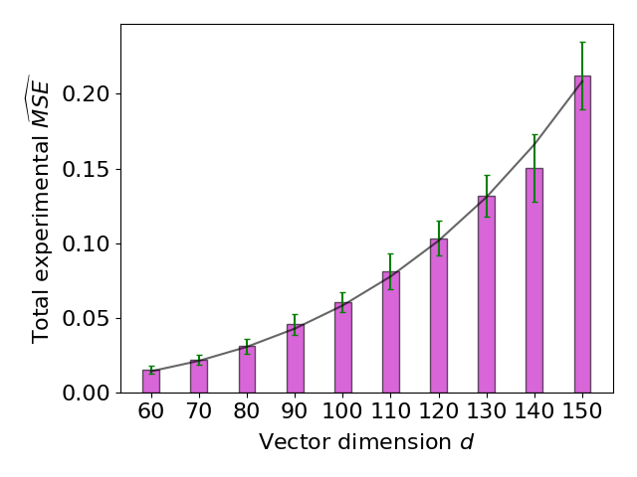
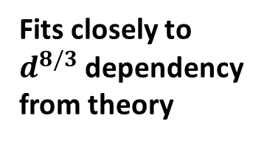
Fits closely to $d^{8/3}$ dependency from theory

Slide 12
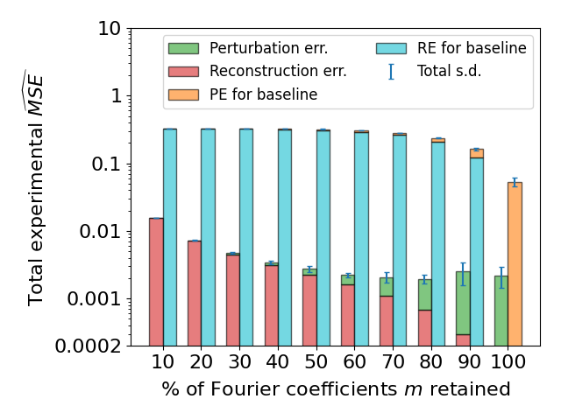

Slide 13
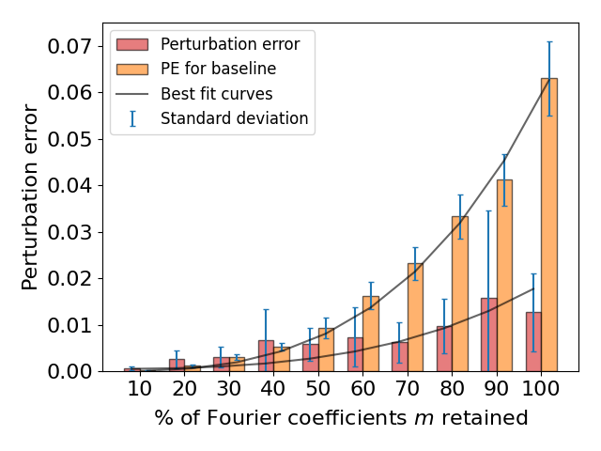

Slide 14
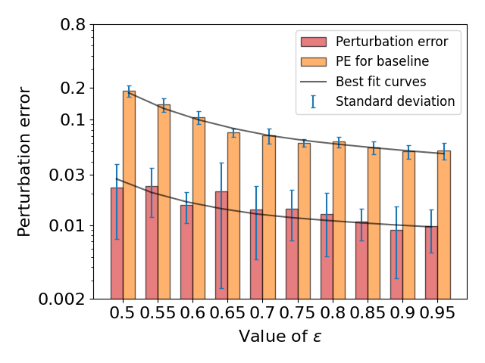

Slide 15
Thank you for listening ☺
Any questions?

